Slide 1
ROB550 Robotic Systems Lab
Winter 2018

Slide 2
Introduction to Robotic Manipulation
Lecture #1
Spong CH1

Slide 3
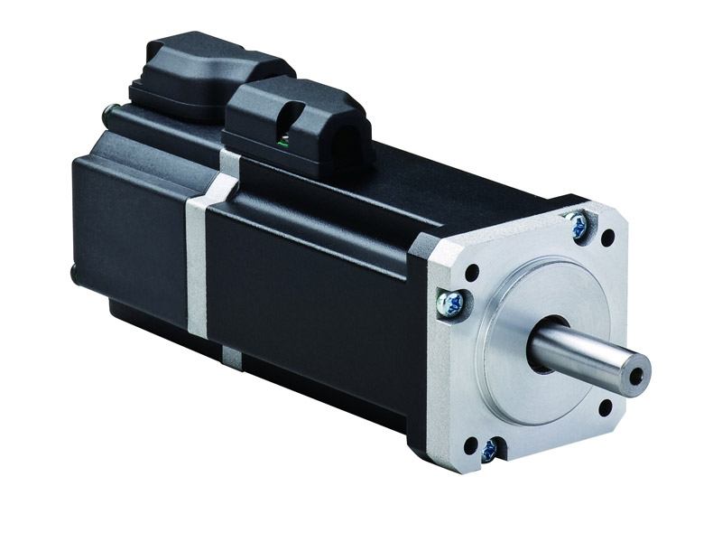
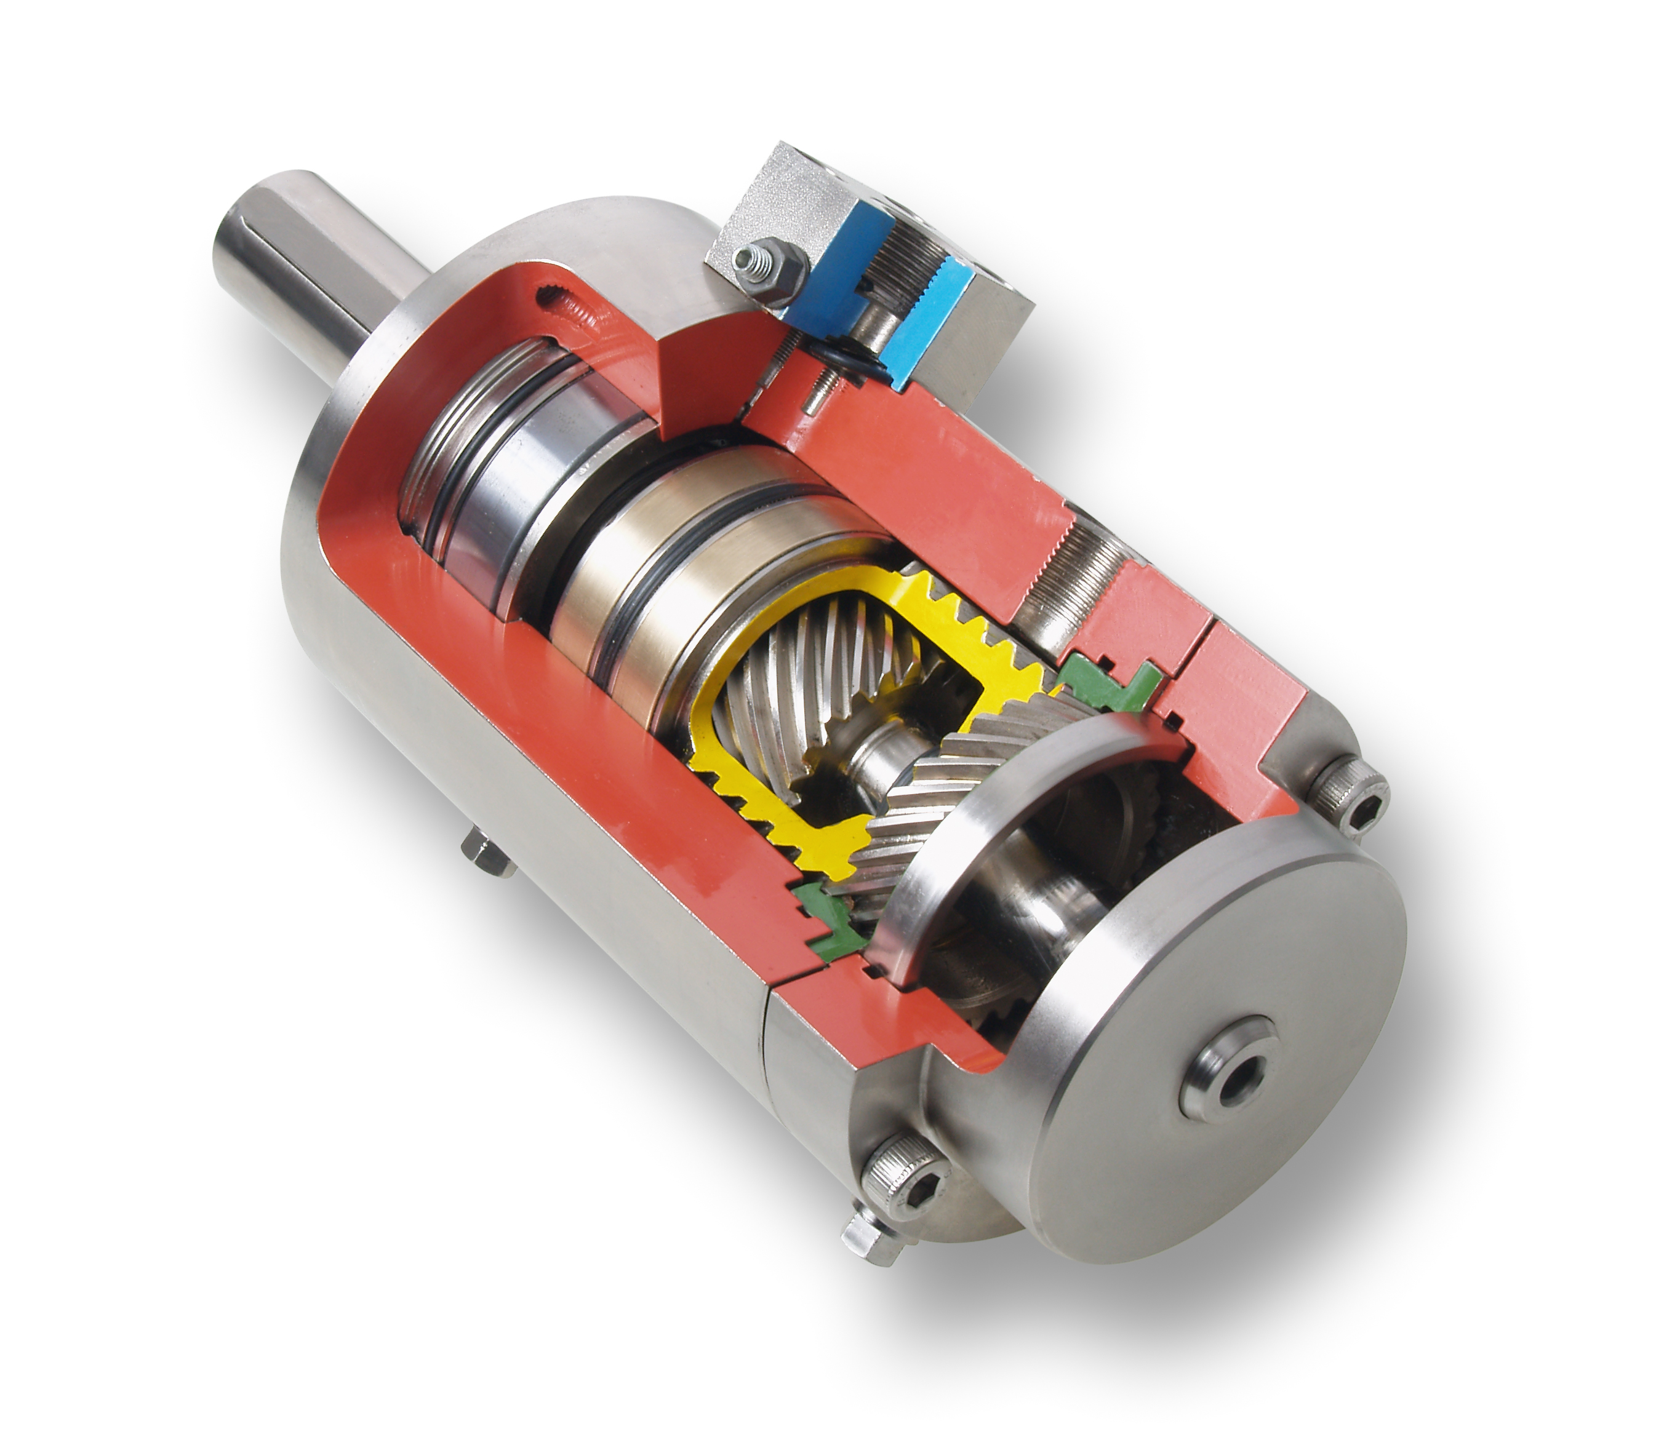
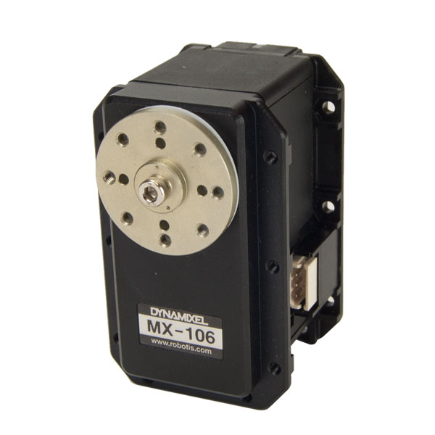
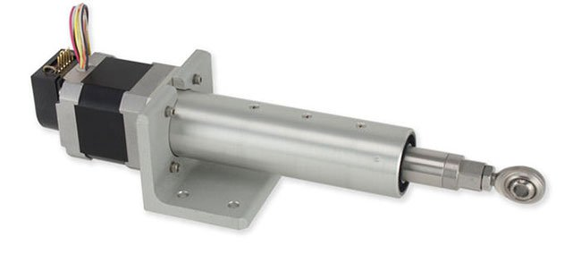
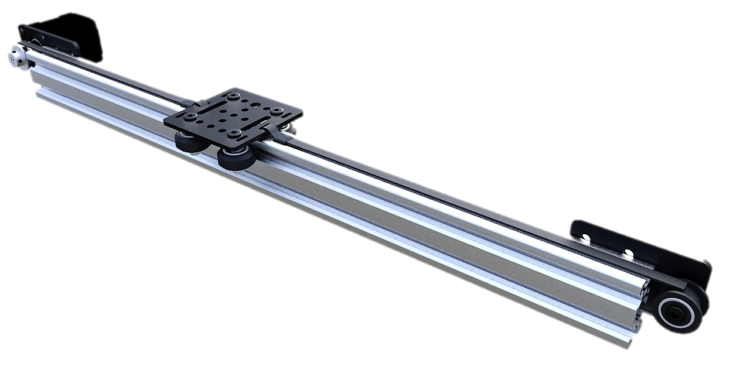
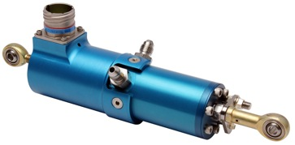
Joints
Two types of actuated joints
Single degree of freedom (DOF)
Rotational → Revolute
Linear → Prismatic

Slide 4
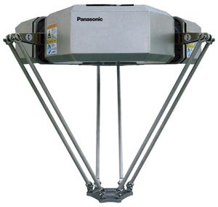
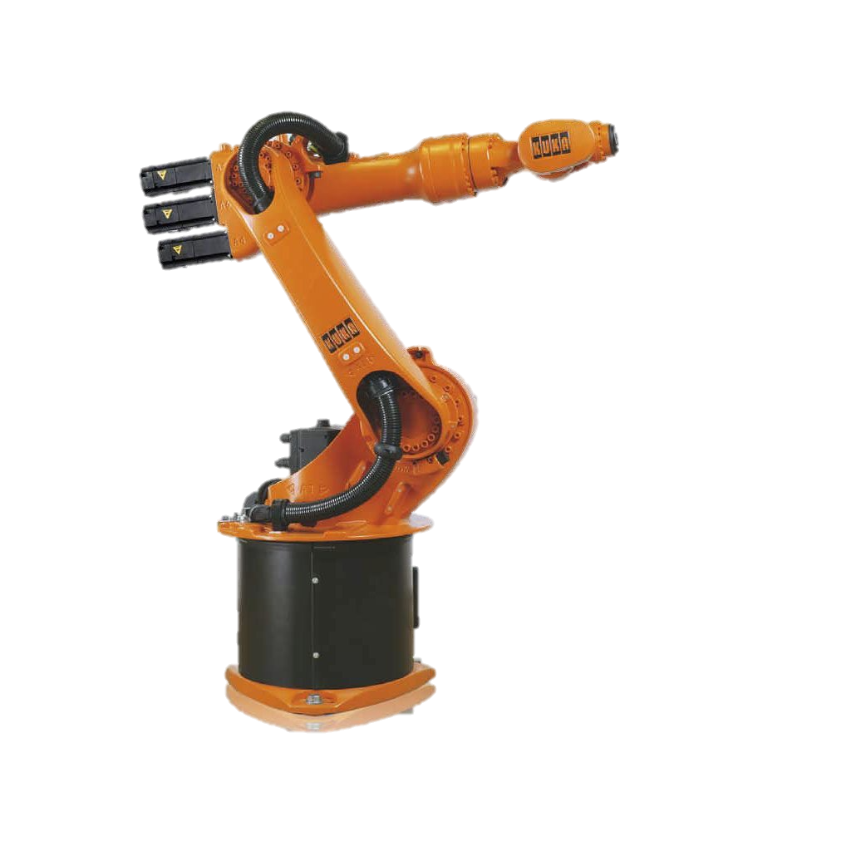
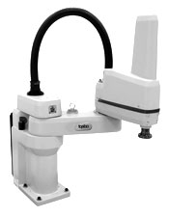
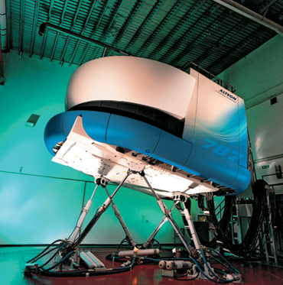
Configurations
Serial: linear kinematic chain
Parallel: two or more kinematic chains in parallel

Slide 5
Serial Kinematic Chains
Serial manipulators composed of Links actuated by Joints
Axis of rotation or translation of joint i is z_{i} .
Configuration is the complete specification of the location of every point on the manipulator.
Configuration is represented as a vector q of joint variables
q = [q₁, q₂, ... q_{n}], q_{i} is θ_{i} for revolute and d_{i} for prismatic joints
A chain has n degrees of freedom if configuration can be specified by n parameters
A chain is kinematically redundant with more than 6DOF

Slide 6
Kinematics
Describes the motion of points, bodies, and systems of bodies .
Forward Kinematics: Compute end effector position and orientation x given configuration vector q.
Inverse Kinematics: Compute joint vector q to yield end effector position and orientation x relative to the base frame.
Forward Kinematics is typically a simple problem for serial manipulators.
Inverse Kinematics problem becomes difficult for high DOF systems.

Slide 7
Common Kinematic Chains
Robotic manipulator often has a base chain (3DOF) and an effector chain (3DOF) to give full 6DOF of end effector
Articulated → RRR
Spherical → RRP
SCARA → RRP
Cylindrical → RPP
Cartesian → PPP

Slide 8
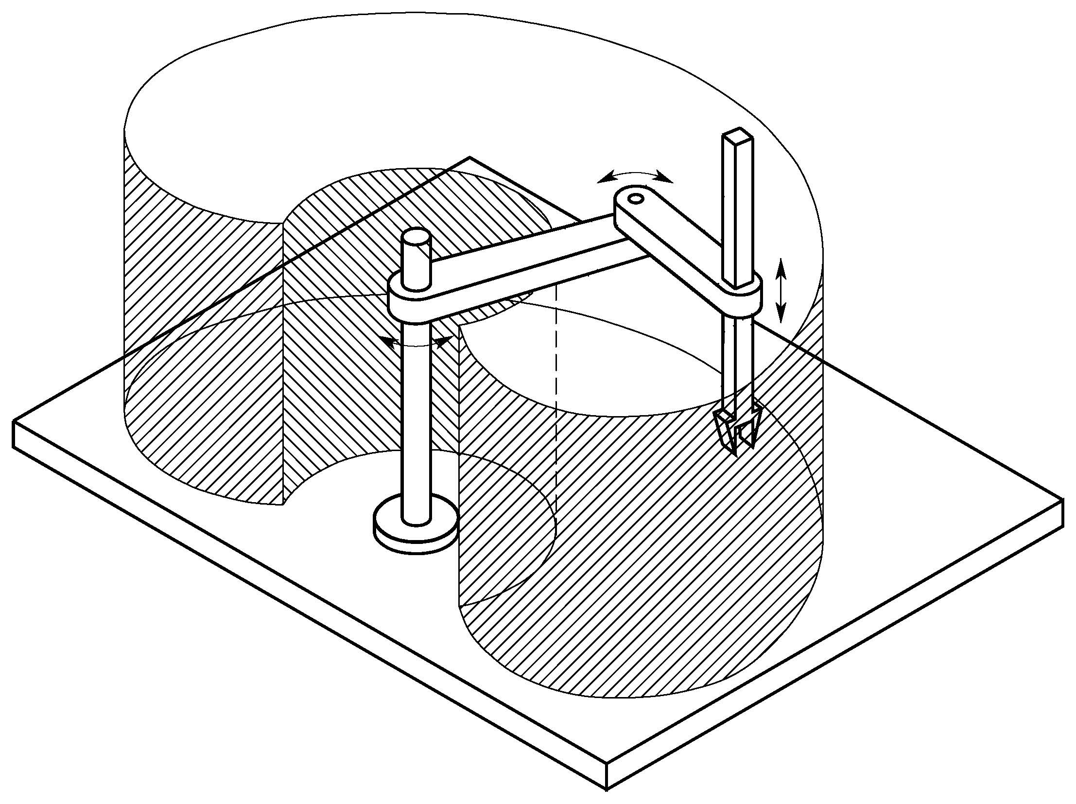
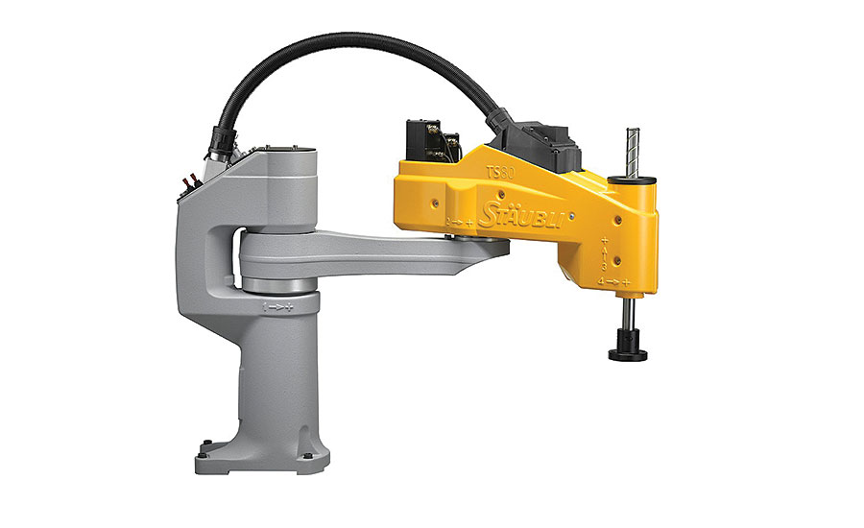
Workspace
Total volume swept out by the end effector as the manipulator executes all possible motions
Reachable workspace: points that can be reached by the manipulator
Dexterous workspace: points that can be reached with arbitrary orientation

Slide 9
Articulated

Slide 10
Spherical

Slide 11
SCARA
Selective Compliant Articulated Robot for Assembly

Slide 12
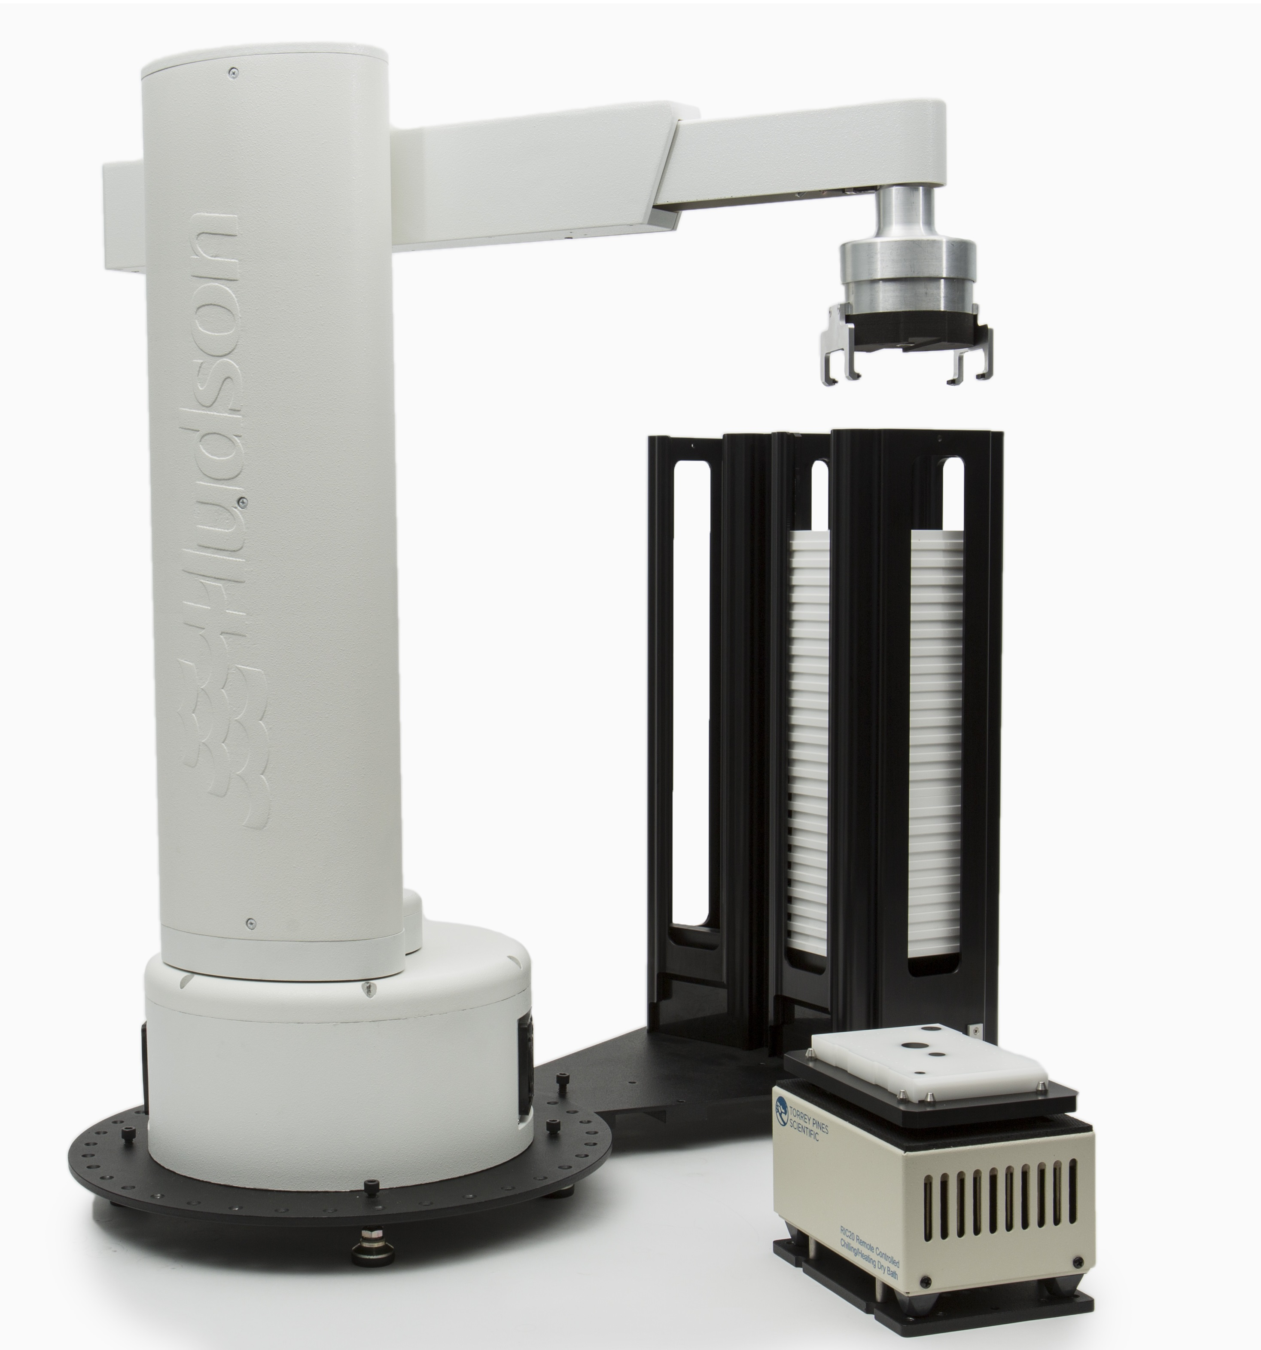
Cylindrical

Slide 13
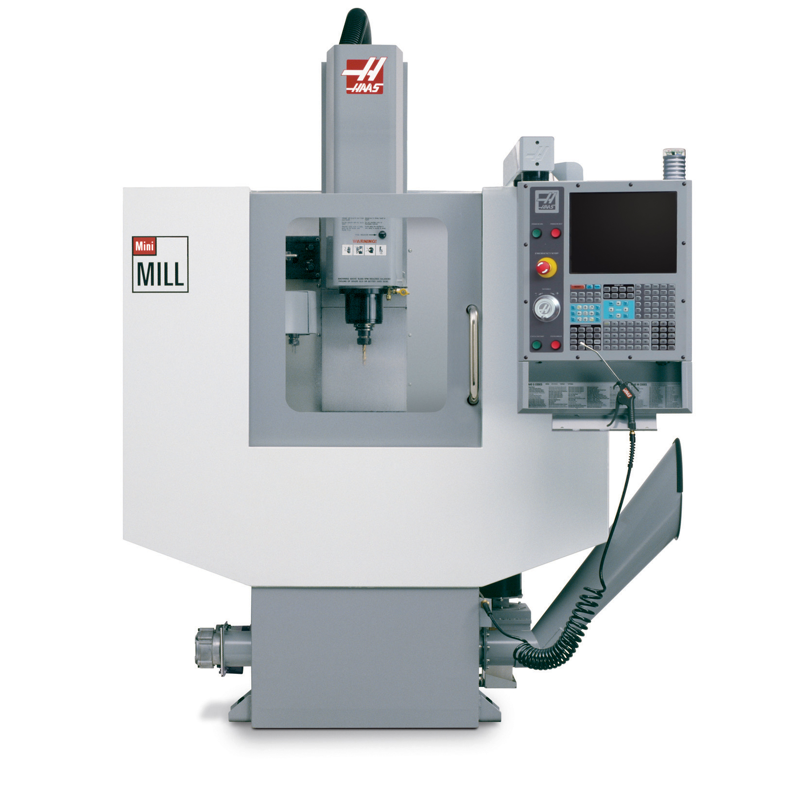
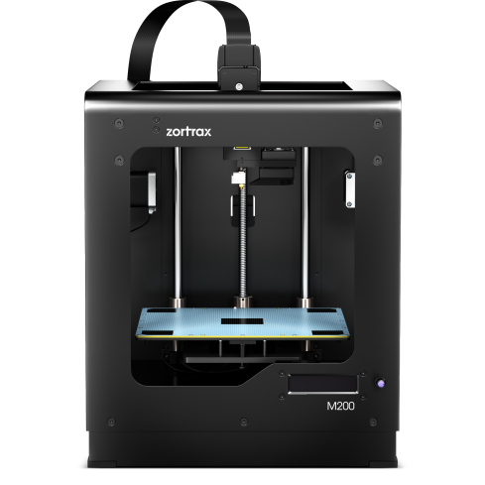
Cartesian

Slide 14
Servo Motors
Lecture #2.1

Slide 15
Servo Motors
A servo measures the absolute rotational position of the output shaft
Uses a feedback loop to control position of the motor
Advanced servos have more advanced feedback loops to control angular velocity and angular acceleration.
Motor
Driver
Motor
Gear
Box
Output
Shaft
Desired
Position
+
-
Position Sensor

Slide 16
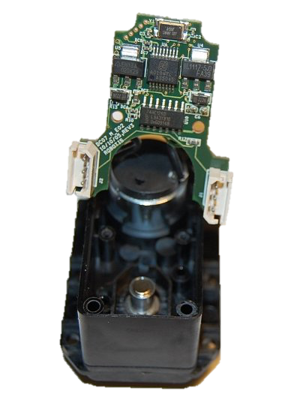
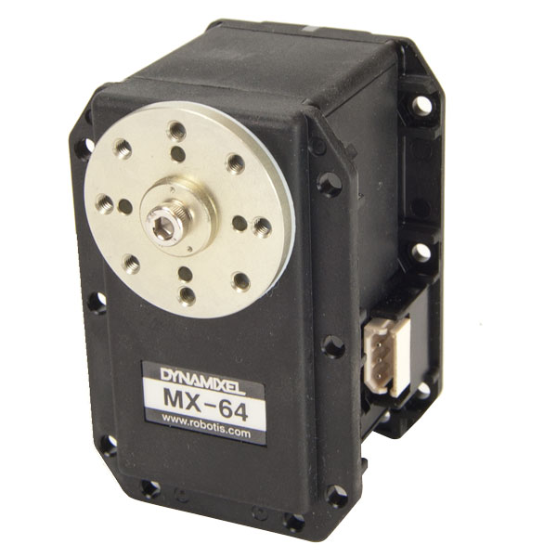
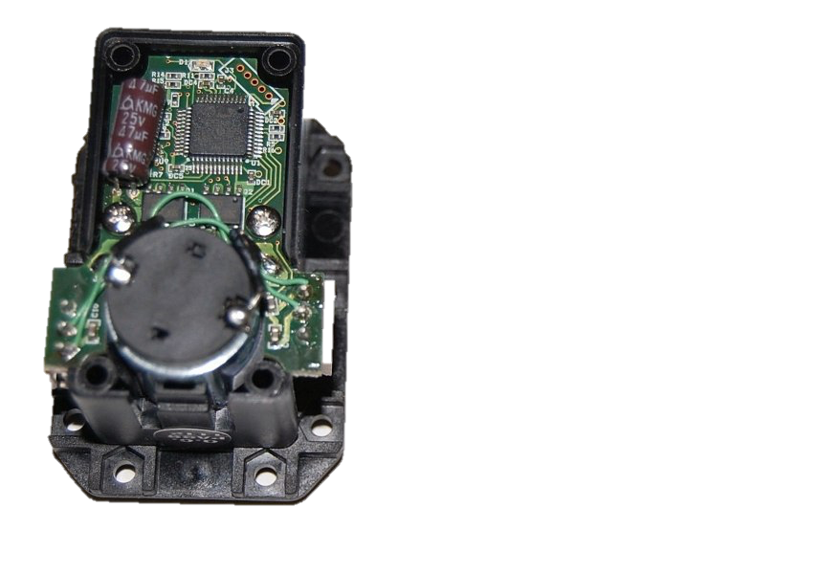
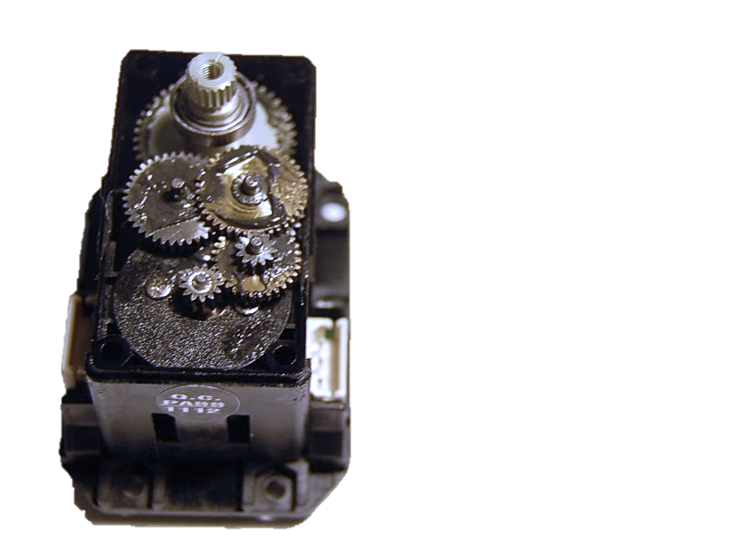
What’s inside?
Magnetic Encoder
ARM M3 Processor
Gear box (193:1)
Motor
Drivers
Magnet
Maxon DC motor

Slide 17
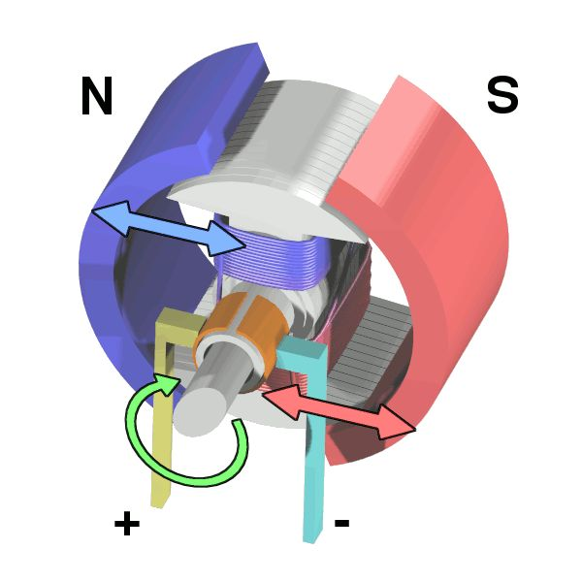
Brushed DC Motor - Basics
DC current produces magnetic fields in coils
Magnetic fields align with those of the permanent magnets
Commutator switches direction of current, and thus polarity of magnetic field to keep motor rotating
Contact to the commutator made with metal brushes (hence the name)
As motor spins, field from permanent magnets creates a back EMF in the coils (generator)

Slide 18
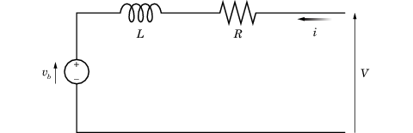
Motor Model
In steady state

Slide 19
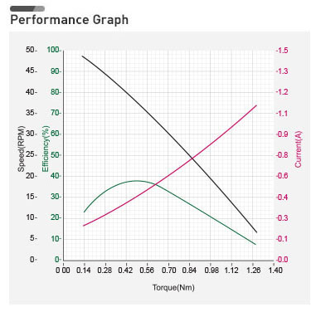
Actual performance
Motor produces most torque and draws most current at low speed
Max torque is produced, and max current is drawn when motor is stalled
Stalling motor could lead to overheating/smoke
Want to limit torque used to fraction of stall torque

Slide 20
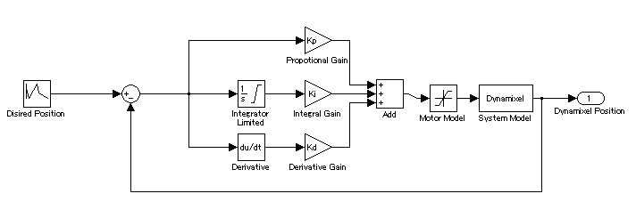
Position Controller XL, MX Series
Simple PID controller

Slide 21
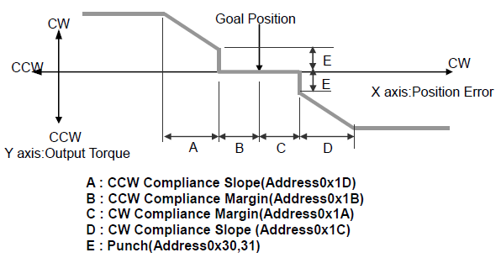
Position Controller AX Series
Proportional Controller with Dead-band & Saturation

Slide 22
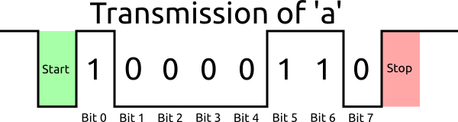
Serial Interface
The Dynamixels uses a standard asynchronous serial protocol
This protocol is similar to RS-232 and RS-485, but uses a single wire for both transmit (TX) and receive (RX)
Uses fixed rate of 1Mbaud, 8 bit transmissions, 1 stop bit, no parity bit

Slide 23
Dynamixel Serial Messages Protocol
Command
1.0
Status
Command
2.0
Status

Slide 24
Dynamixel Driver
In this lab, we will use dynamixel driver to handle the low level serial interface (so you don’t have to).
Communication with the driver is handled using LCM.
LCM is a system for sharing data between different programs/computers using network protocols, specifically UDP Multicast.
LCM works with and can share data between many different programming languages.
It is similar (but more efficient) to ROS messages
There is an LCM tutorial on the google drive.

Slide 25
Python LCM subscription
def main(): lc = lcm.LCM() subscription = lc.subscribe("LCM_CHANNEL", lcm_channel_handler) try: while True: lc.handle() #blocks until message recieved except KeyboardInterrupt: pass lc.unsubscribe(subscription)

Slide 26
Python LCM publishing
def main(): # initialize LCM lc = lcm.LCM() # call the constructor for the lcmtype object lcm_msg = lcm_msg_t() # fill the msg with data lcm_msg.data = 1024 #publish message to lcm lc.publish("LCM_CHANNEL", lcm_msg.encode())

Slide 27
Command Message
struct dynamixel_command_t { int64_t utime; // position of servo in radians, [-pi, pi]. A command of zero // corresponds to the mid-way position (indicated on the // servo by a position notch.) double position_radians; double speed; // how fast to move to new position [0, 1] double max_torque; // torque limit [0, 1] }

Slide 28
Feedback Message
struct dynamixel_status_t { const int32_t ERROR_VOLTAGE = 1, ERROR_ANGLE_LIMIT = 2, ERROR_OVERHEAT = 4, ERROR_OVERLOAD = 32; int64_t utime; int32_t error_flags; double position_radians; // position of servo in radians, [0, 5.2333] double speed; // unsigned measure of angular velocity, [0, 1] double load; // measure of motor current, [-1, 1] double voltage; // supply voltage (volts) double temperature; // temperature (celsius) }

Slide 29
Configuration Messages
struct dynamixel_config_t { int64_t utime; // these are for MX and XL motors byte kp; //0-255 default: 32 byte ki; //0-255 default: 0 byte kd; //0-255 default: 0 //these are for AX motors byte compl_margin; byte compl_slope; //this is for all motors byte LED; //0,1 for AX/MX to turn on and off, 0b111 for XL RGB LED }

Slide 30
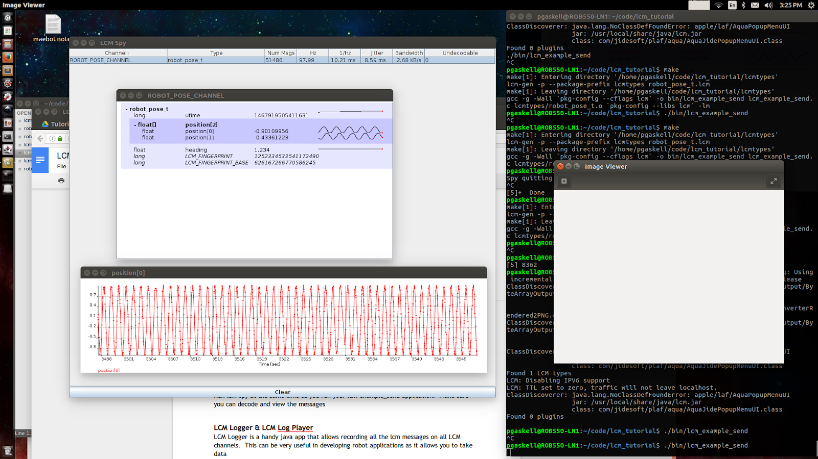
LCM Spy
Java application to probe LCM traffic
Must know location of java archive of lcmtypes
Java lcmtypes auto generated in our repos with Makefile
$> source setenv.sh

Slide 31
LCM Logs
You can record LCM traffic with lcm-logger
You can playback LCM traffic with lcm-logplayer-gui
You can write a simple program to decode log files to data files for plotting with matplotlib, Matlab etc.

Slide 32
Rigid Body & Other Transformations
Lecture #2.2 Spong CH2

Slide 33
Points & Frames

Slide 34
Planer Rotations
Column vectors are unit vectors of frame 1 in frame 0

Slide 35
Planer Rotations
We could also express:
Because dot product is commutative

Slide 36
Planer Rotations
Geometrically, the orientation of Frame 1 w.r.t Frame 0
Is the inverse of the orientation of Frame 0 w.r.t Frame 1
We refer to this property as orthonormal. Rotation matrices are members of the special orthonormal group
Properties:
Mutually orthogonal rows & columns

Slide 37
Review 2D Transformations in Homogeneous Coordinates
Rotation
Translation
Scale
Rigid Body
Shear in x
Shear in y
Reflect about y
General Affine Transformation

Slide 38
More slides on Rotation & Homogeneous Coordinates will be added soon…

Slide 39
Transforms & Camera Calibration
Lecture #3

Slide 40
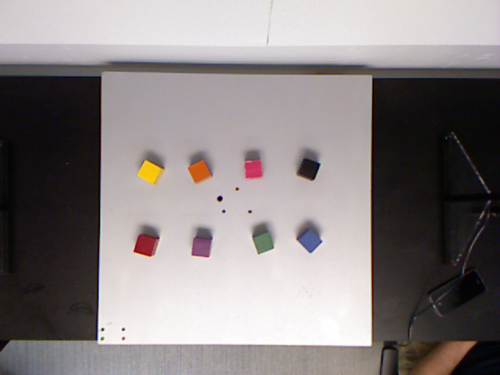
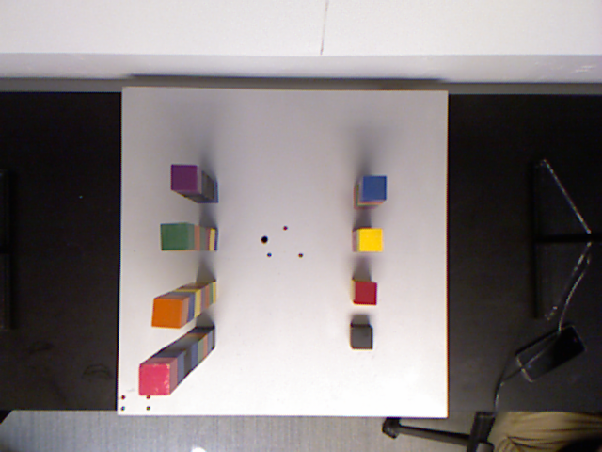
The Problem:
Given an object detected in an image,
what is its location in workspace coordinates?

Slide 41
Simple pinhole model of a camera

Slide 42
In Matrix form

Slide 43
Pinhole Model Intrinsic Matrix

Slide 44
Other Considerations…
Optical axis not centered on sensor
Pixel coordinate system origin in corner of sensor
Pixels aren’t square
Don’t know pixel size

Slide 45
Camera intrinsic matrix
Transforms Camera Frame to Image Plane
Depends on geometry of camera, physical characteristics of sensor, details of the image digitization

Slide 46
Full Projection Matrix
intrinsic
projection
extrinsic
Camera to Image
(Intrinsic)
World to Camera
(Extrinsic)

Slide 47
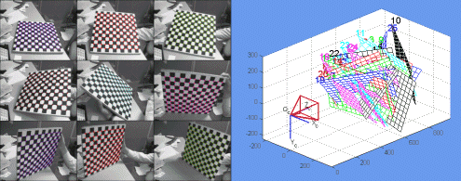
Finding the intrinsic matrix
Must perform camera calibration
Collect many images of known points and compute
camera_cal.py will give you this (units of pixels)
Jean-Yves Bouguet

Slide 48
Workspace Calibration – Fixed Distance & Camera Aligned
If the camera Z-axis is aligned with world Z-axis, and all points of interest lie in the X,Y plane a known distance away, we can ignore the Z coordinates
The Extrinsic matrix can then be expressed as a 2D homogenous transform
The intrinsic projection matrix then can be expressed as a 3x3 invertible affine transformation

Slide 49
What if we want to go the other way? Pixel -> World

Slide 50
Affine Transformation
If the camera is directly overhead, and a fixed distance from all objects, we can use an Affine transformation
Scale, Rotation, Translation, Skew

Slide 51
How to find an Affine transform
Collect a set of known correspondent points – i.e. pixel coordinates of known points on the board

Slide 52
How to find an Affine transform
Multiply out

Slide 53
How to find an Affine transform
Rearrange into form

Slide 54
How to find an Affine transform
Solve
Invert, Only works if A is square (3 correspondences)
Pseudo inverse, least squares for N>3
Now you have the values to generate the Affine transformation matrix

Slide 55
Kinect gives depth
Depth data is a 10 bit number (0-1024)
Need a function get depth in meters. An example:

Slide 56
Inverse of Intrinsic Matrix
With depth information we can effectively undo the projection…
This assumes no shear... Otherwise use

Slide 57
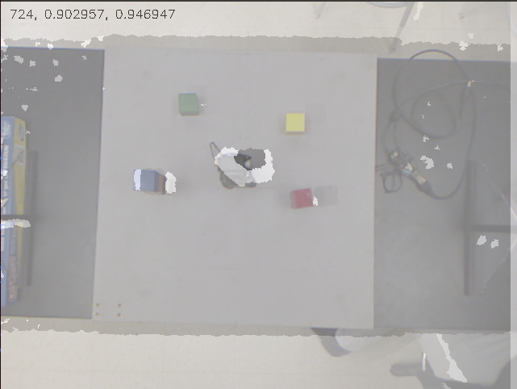
Caveat: Depth & RGB camera not aligned
(u, v) pixel in depth image not the same as (u, v) of RGB
Solution: use an affine transform!

Slide 58
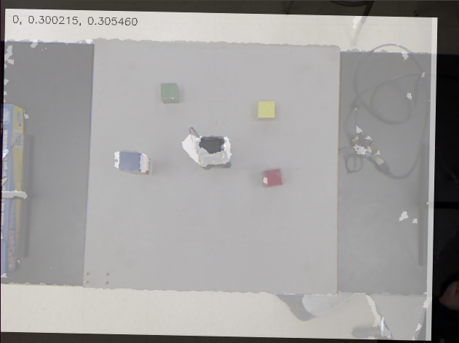
Affine transform to align depth & RGB image
After applying Affine Transform to depth image, RGB pixels and depth pixels are roughly aligned
Can find depth at the centroid of the blocks from the output of your blob detector, look up depth value, and transform (u,v,d) to (x,y,z) using a transformation matrix

Slide 59
Transform Camera Frame to Rexarm Frame
Use use mouse clicks to align origin and axes to perform this final transformation.

Slide 60
Trajectory Generation
Lecture #4.1
Spong 5.5

Slide 61
Task to Trajectory
Sequence of Waypoints in World
Interpolation
in World
World Coordinates
Task Planning
Conversion with Inverse Kinematics
World to Configuration
Conversion with Inverse Kinematics
Sequence of Waypoints in
Configuration Space
Interpolation
in Configuration Space
Configuration Space

Slide 62
Trajectory Smoothing
Smoothing trajectories allows:
Limiting accelerations
Limiting vibrations
Higher precision
Less wear in motors

Slide 63
Cubic Polynomial Trajectories
Given boundary conditions define a polynomial with 4 coefficients:

Slide 64
Cubic Polynomial Trajectories
Plugging in t₀ and t_{f} this gives us 4 equations w/ 4 unknowns

Slide 65
Cubic Polynomial Trajectories
Can be rearranged in matrix form to solve for a

Slide 66
Cubic Polynomial Trajectories
Cubic polynomial creates smooth position and velocity curves
Acceleration is discontinuous
System naturally limits acceleration (due to inertia)
Still large jerk (derivative of acceleration) can be harmful

Slide 67
Quintic Polynomial
Allows boundary condition on acceleration
Limits Jerk

Slide 68
Linear Segments with Parabolic Blends

Slide 69
Trapezoidal vs. S-Curve
Using parabolic blends on the trapezoidal velocity profile gives an S-Curve profile with a trapezoidal acceleration profile. This limits jerk.

Slide 70
Stitching together waypoints
Cubic Spline
Quintic
Spline

Slide 71
Ways to choose velocity at waypoints
User specifies velocities in terms of angular velocities for each motor (could be 0)
System chooses velocities at the waypoints to ensure acceleration through the points is continuous
Same direction,
v = slope
Change directions, v=0

Slide 72
Implementation
“Look ahead” when commanding position waypoints and set the speed command to the desired velocity at each time step.
When deciding time, look at largest joint displacement and and decide some metric…
When reporting “low” and ”high” speed playback, you should be adjusting this metric

Slide 73
Deterministic Finite State Machines
Lecture #4.2

Slide 74
Deterministic Finite State Automaton

Slide 75
Simple Example – Elevator Door

Slide 76
Adding Intermediate States
UO / UC = User Open/Close
SO / SC = Sensor Open/Close

Slide 77
Implementation in Switch Case
switch(currentState) { case DOOR_CLOSING: close_door(); if(sensor = closed) currentState = DOOR_CLOSED; if(button = open) currentState = DOOR_OPENING; case DOOR_OPENING: open_door() if(sensor = open) currentState = DOOR_OPEN; if(button = close) currentState = DOOR_CLOSING; case DOOR_CLOSED: if(button = open) currentState = DOOR_OPENING; case DOOR_OPEN: if(button = close) currentState = DOOR_CLOSING; default: throw_error();

Slide 78
Let’s Draw a State Machine for Moving the Arm!

Slide 79
Forward Kinematics
Lecture #5.1
Spong CH3.1 – 3.2

Slide 80
Review Rigid Body Homogeneous Transformations

Slide 81
Building the R matrix
Basic Rotation Matrices

Slide 82
Denavit – Hartenberg Convention

Slide 83
More slides on Kinematics will be added soon…

Slide 84
Inverse Kinematics
Lecture #5.2
Spong CH3.3

Slide 85
More slides on Kinematics will be added soon…

Slide 86
Differential Kinematics
Lecture #6.1
Spong CH4

Slide 87
Differential Kinematics
Motivation: consider an n-link serial chain manipulator with joint variables:
This manipulator can be described by the forward kinematic matrix

Slide 88
End Effector Velocity
Want to find the end effector velocity given the joint velocities

Slide 89
The Jacobian
Forward kinematics gives us
If we want to know how moving one joint moves our end effector…
The expression for this for all joint variables is the Jacobian

Slide 90
Building the Geometric Jacobian
The linear velocity of the end effector frame is
The angular velocity of the end effector frame is
Is 3 x n matrix
is 3 x n matrix
is 6 x n matrix

Slide 91
Building the Geometric Jacobian

Slide 92
Building the Geometric Jacobian

Slide 93
Anthropomorphic Arm
3DOF Serial revolute manipulator

Slide 94
Singularities
The 6 x n Jacobian defines a mapping
This implies all possible end-effector velocities are linear combinations of the columns of the Jacobian
When J has rank 6, we can move with arbitrary velocities, but when rank(J) < 6 or <n for an n-DOF arm, we are in a “singular” configuration

Slide 95
Singularities
Singularities represent configurations where certain directions of motion are unobtainable
At singularities, bounded end-effector velocities may correspond to unbounded joint velocities
At singularities, bounded end-effector torques may correspond to unbounded joint torques.
Singularities usually correspond to points on the boundary of the workspace.
Singularities may correspond to points in the workspace that are unreachable.
Near a singularity there will not exist a unique solution to the inverse kinematics problem. There may be no solution or infinite solutions.

Slide 96
Singularities

Slide 97
Inverse Velocity and Acceleration
The Jacobian relates the joint velocity to the end effector velocity
For a square Jacobian we can invert it and find joint velocities given a velocity we with the end-effector to have
Even if it is not square, it turns out you can use the pseudo inverse

Slide 98
Differential Inverse Kinematics
This relationship allows differential inverse kinematics
Paths in workspace can be achieved by following an end-effector velocity profile when joint velocity commands are found using the inverse Jacobian
This scheme works as long as singularities are avoided
Often this is the simplest way to plan complex paths in workspace, especially for kinematically redundant manipulators.

Slide 99
Balancebot Hardware Intro

Slide 100
Brushed DC Motor - Basics
DC current produces magnetic fields in armature
Magnetic fields align with those of the permanent magnets
Commutator switches direction of current, and thus polarity of magnetic field to keep motor rotating
Contact to the commutator made with metal brushes
As motor spins, field from permanent magnets creates a back EMF in the coils (generator)

Slide 101
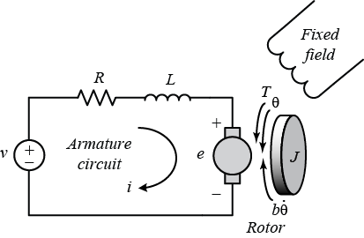
Motor Model
R - armature resistance (Ω)
L - armature inductance (H)
v – applied voltage (V)
e – back EMF (V)
T – motor torque (N.m)
𝜃 - position (rad)
b – friction coefficient (N.m)

Slide 102
Motor Model

Slide 103
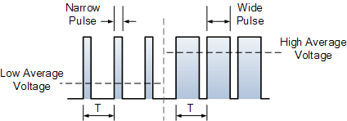
Pulse Width Modulation (PWM)
Motor acts as a low pass filter (R-L filter)
Can control speed with a “digital” PWM signal at high frequency
Lower inductance motors require higher frequency
PWM has a frequency/period & a duty cycle/pulse width

Slide 104
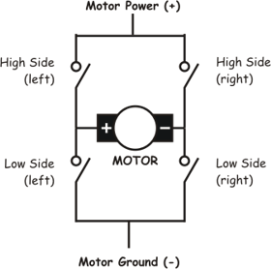
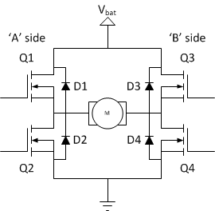
H-Bridge

Slide 105
Normal Operation
Forward
Reverse

Slide 106
Normal Operation
Brake
Coast

Slide 107
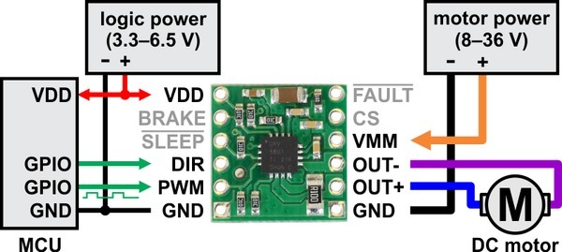
Balancebot Motor Driver

Slide 108
Motor Driver Module Control
Motor Driver Module Truth Table
PWM | DIR | BRAKE | OUT+ | OUT- | operating mode
PWM | 1 | 1 | PWM (H/L) | L | forward/brake
PWM | 0 | 1 | L | PWM (H/L) | reverse/brake
L | X | 1 | L | L | brake low
PWM | 1 | 0 | PWM (H/OPEN) | PWM (L/OPEN) | forward/coast
PWM | 0 | 0 | PWM (L/OPEN) | PWM (H/OPEN) | reverse/coast
L | X | 0 | OPEN | OPEN | coast

Slide 109
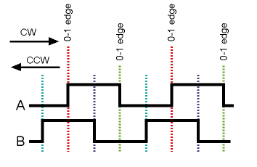
Measuring Speed & Direction: Quadrature Encoder
A
B

Slide 110
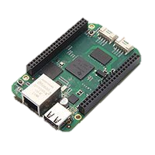
Beaglebone Green
1GHz AM335x ARM Cortex A8 | 3x hardware quadrature decoders
512MB DDR3 RAM | 3x 2 channel hardware PWMs
4GB on-board flash storage | Analog: 7 channel 10bit ADC
NEON floating-point accelerator | Serial: 2 i2c, 2 SPI, 5 UARTs
2x PRU 32-bit microcontrollers | Most pins can be GPIO
USB 2.0 (host & client) 100Mb Ethernet | $45

Slide 111
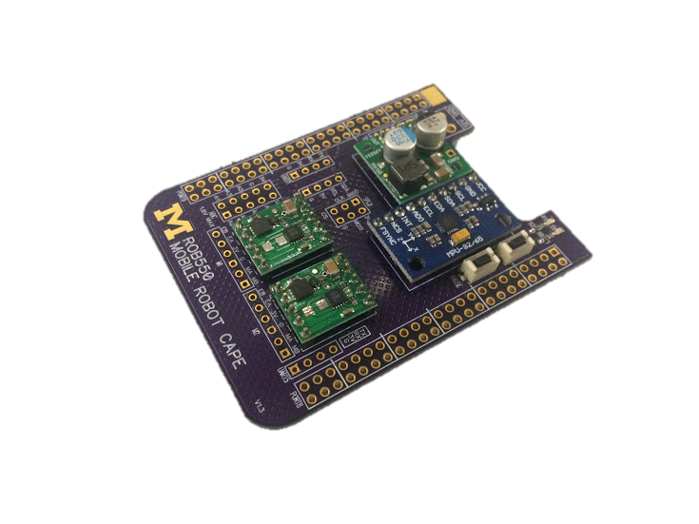
Mobile Robot Cape
Voltage Regulator
2 Motor Drivers
2 Quadrature Decoders
1 IMU (gyro + accel + mag)
2 buttons
2 indicator LEDs
4 serial ports
2 UART, i2C, SPI
7 ch ADC
DSM RC receiver interface

Slide 112
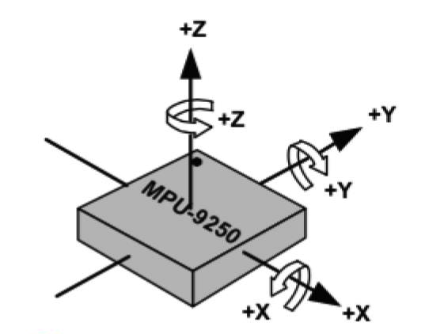
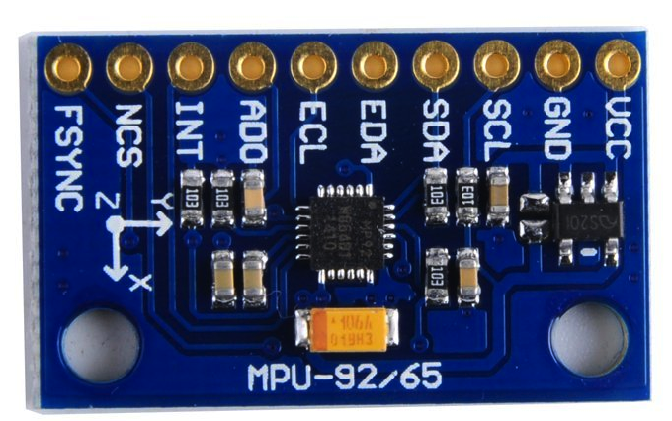
IMU – MPU9250
Accelerometer, Gyroscope, Magnetometer
Contains data-fusion processor – DMP
DMP interrupts BB at fixed rate

Slide 113
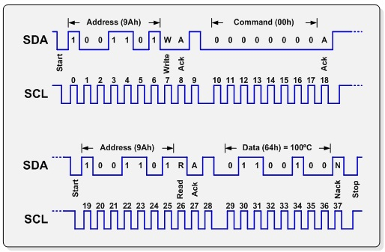
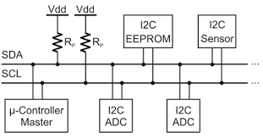
Inter-IC Communications – i2C

Slide 114
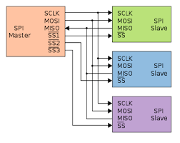
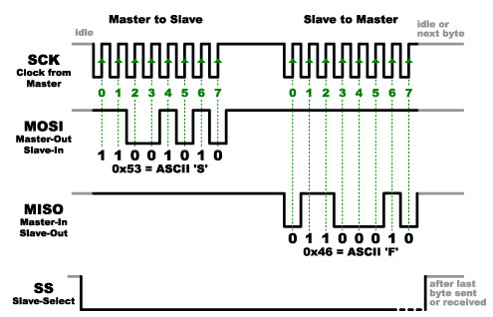
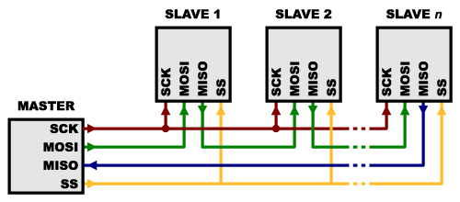
Serial Peripheral Interface - SPI
Parralel
Serial

Slide 115
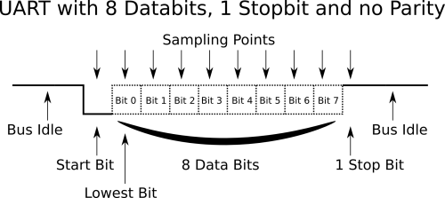
Asynchronous Serial Interface
(Universal Asynchronous Receiver Transmitter)
Separate TX and RX pins, fixed baud rate

Slide 116
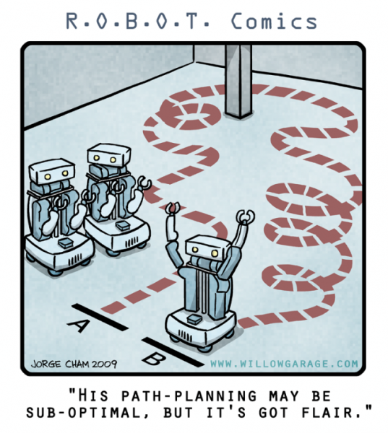
Path Planning

Slide 117
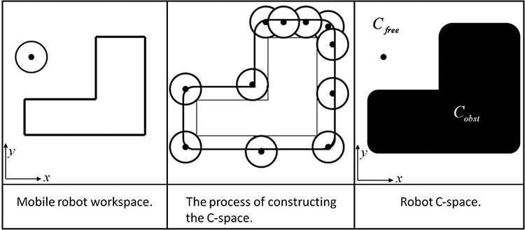
Configuration Space
Portion of space the robot can occupy.
Reduces robot to a point.

Slide 118
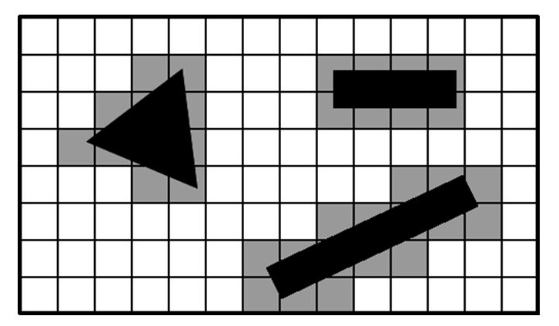

Occupancy Grid
Represent space as a grid of occupied, or free cells

Slide 119

Visibility Graph
Make obstacles in C-space polygons
Set node at each vertex
Set node at start and goal
Edges between nodes based on visibility
Must use collision detection to build edges

Slide 120

Voronoi Graph
Paths are points where distance to the two nearest obstacles are the same
Paths favor moving the robot through the middle of large open spaces

Slide 121

Voronoi Graph

Slide 122


Probabilistic Roadmap (PRM)
Randomly sample free points in C-space to generate nodes
Connect edges to visible nodes within a horizon

Slide 123

Rapidly Exploring Random Tree (RRT)
Randomly explore space, biased towards the goal
Tree will eventually fill space efficiently
Can grow from start and goal and stop when trees meet

Slide 124



Potential Field Planning

Slide 125

Repulsive Potential for Obstacles

Slide 126

Attractive Potential for Goal

Slide 127
Problems with Potential Fields – Local Minima
Critical points (where ∇U(q) = 0) are problems
Represent local maxima, minima and saddle points.
Can use a random walk to get out.
Navigation Functions are special potential field constructions with no local minima, only one minimum point for the goal
A Wavefront planner is a simple potential field planner on a grid, is not optimal, but avoids these critical points.

Slide 128

Wavefront Planner
Assign obstacles in occupancy grid a value of 1, and goal a value of 2.

Slide 129

Wavefront Planner
Starting with the goal set adjacent cells to +1 and repeat…

Slide 130

Wavefront Planner
When complete start cell has a number.
only unnavigable areas should be 0.

Slide 131

Wavefront Planner
Shortest path is found by always moving to a cell with a lower value.

Slide 132
Finding a path - Graph Search
Breadth First Search
Depth First Search
A*
Dijkstra’s Algorithm
Greedy search
Dijkstra’s and Greedy are two special cases of A*
…to the chalk board!

Slide 133
Grid Search A* Movie…
https://www.youtube.com/watch?v=-L-WgKMFuhE

Slide 134
Basic Probability
Probabilistic Robotics CH2.2

Slide 135
Random Variables
Random variables can take on any value
Variables can be discrete i.e. coin toss (heads|tails)
Variables can be continuous i.e. range finder measurement in meters
The probability a random variable has a certain value is
Example -> coin toss:

Slide 136
Probability Density Functions
Probabilities of discrete variables sum to one:
Probabilities of continuous variables are a probability density function whose integral over all values is
Common P.D.F. is the Gaussian or Normal distribution with mean and variance
We commonly write this specifying the variable, mean and variance:

Slide 137
Joint Probability
The joint probability of 2 variables is
If these are independent
Conditional probability: probability of one variable given known value of another variable
If two variable are independent,
Chain rule

Slide 138
Bayes Rule
Bayes rule allows us to infer the conditional probability of A given B, based on the inverse conditional probability of B given A, and the independent probabilities of A and B.

Slide 139
Bayes’ Rule
If A is a quantity we would like to infer from data B:
p(A) is the prior probability of A
p(A|B) is the posterior probability after taking data B into account
p(B|A) is the likelihood of the data given the hypothesis
p(B) is the prior probability of the data and effectively normalizes the posterior to one.

Slide 140
Why is Bayes’ Rule so useful
Diagnostic evidence p(disease | symptom) is often hard to get but what you want to know.
Causal evidence p(symptom | disease) is often easier to get.
p(disease) is easy to get
p(symptom) is just a normalizer

Slide 141

Door Sensor Example
Your robot has a noisy discrete sensor for detecting if a door is open or closed.
If the door is open, then 70% of the time the sensor reads HIGH. But 30% of the time it reads LOW.
If the door is closed, then 90% of the time the sensor reads LOW. But 10% of the time it reads HIGH.

Slide 142
Door Sensor Example
Your sensor gives you 5 consecutive measurements:
HIGH, LOW, HIGH, LOW, HIGH
What do you conclude?
1. The sensor is worthless
2. It is likely the door is closed
3. It is slightly more likely than not door is closed
4. It is much more likely that the door is closed

Slide 143
Door Sensor Example
What is the probability your sensor would read
HLHLH
if the door is open?
What is the probability your sensor would read
HLHLH
if the door is closed?
We have these pieces of information:
p(H|O) = 0.7
p(L|O) = 0.3
p(H|C) = 0.1
p(L|C) = 0.9
p(O) = 0.5
p(C) = 0.5

Slide 144
Door Sensor Example
What is the probability your sensor would read
HLHLH
if the door is open?
What is the probability your sensor would read
HLHLH
if the door is closed?
We have these pieces of information:
p(H|O) = 0.7
p(L|O) = 0.3
p(H|C) = 0.1
p(L|C) = 0.9
p(O) = 0.5
p(C) = 0.5
p(HLHLH|O) = 0.7 * 0.3 * 0.7 *0.3 * 0.7 = 0.03087
p(HLHLH|C) = 0.1 * 0.9 * 0.1 * 0.9 * 0.1 = 0.00081

Slide 145
Door Sensor Example
Let S equal the sensor sequence HLHLH.
What is the probability of the door being open given the sequence S p(O|S)?

Slide 146
Using Conditional Probability to make a map
Given robot poses x_{1:t} and laser rangefinder measurements z_{1:t} infer a map of the environment
Expressed probabilistically as
Double circle is known variable
Arrow indicate generation
Single circle is latent variable

Slide 147
Occupancy Grid Mapping
Map is a M x N matrix of cells
Cell is either occupied or unoccupied
Probability p(m_{i}) is probability cell is occupied
Map can be inferred from a Bayes filter with a static state

Slide 148
Odds Ratio & Log Odds
A is binary state occ(i,j) and B is sensor reading
Probability a cell is occupied p(occ(i,j)) = p(A) has range [0,1]
Probability a cell is free p(¬A)
Odds of being occupied o(occ(i,j)) = p(A)/p(¬A) has range [0,∞]
Log odds log o(occ(i,j)) has range [-∞,∞]
Each cell C(i,j) holds the value of log o(occ(i,j))
C(i,j) = 0 corresponds to p(occ(i,j)) = 0.5

Slide 149
Bayes’ Law using Odds
Bayes’ Law:
Likewise:
So:
Where:

Slide 150
Updating the map using Bayes’ Law
Bayes’ Law can be written as
Take log odds to make multiplication into addition
For each cell take add the evidence into the cell
posterior
Sensor
update
prior

Slide 151
Map Update Algorithm
Given o_{t-1}(m_{i}), x_{t}, z_{t}:
for all cells in m:
if m_{i} is observed in z_{t}
o_{t}(m_{i}) = o_{t-1}(m_{i})+sensor_inverse(C_{ij},z_{t},x_{t})
else
o_{t}(m_{i}) = o_{t-1}(m_{i})
endif
endfor

Slide 152

Sensor Model
Probability of reading a range given known occupancy at known distance

Slide 153
Inverse Sensor Model
If laser terminates at C_{ij} at distance D
If the laser passes through C_{ij}

Slide 154
Implementation
Rasterize each laser ray into the map to determine cells that are currently visible and free or occupied
Convert known pose (x,y,𝜃) to start cell and reading (𝜃,d) to end cell in the map
Use Breshenham’s algorithm to update cells along the ray

